Slide 1

Data Challenge 2022 Pitch Project
Ruben Robles

Slide 2
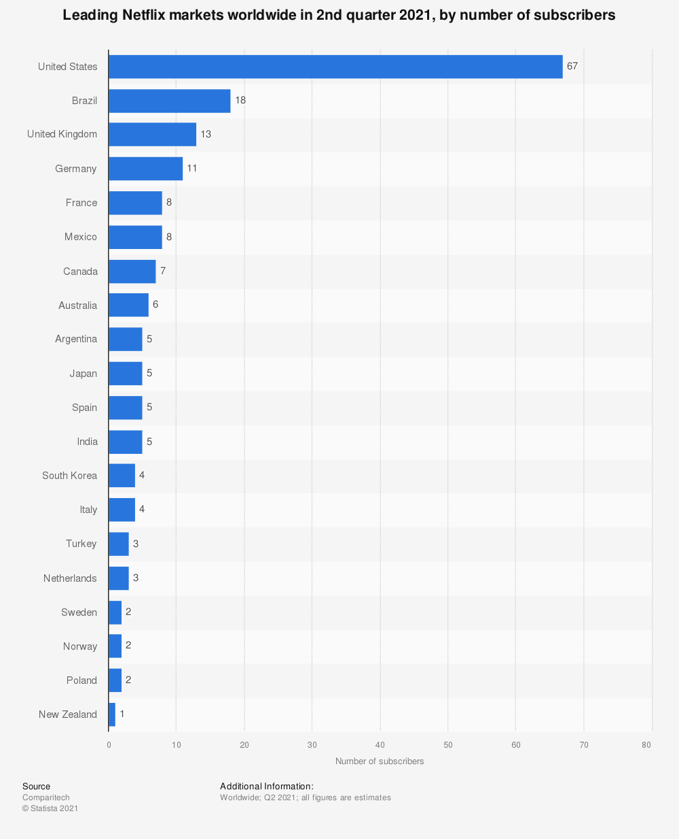
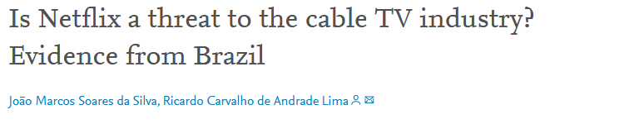
Why Brazil?
“Brazil ranked second with around 18 million subscribers. Latin America in particular is a growing market for the Netflix, and subscriber numbers in the region hit around 35 million in the second quarter of 2021.”

Slide 3
3 Key Insights
1. Kid’s focused content, and family friendly content in general, is currently underserved by Netflix
2. There is an oversaturation of Crime TV Shows in Brazil, and Latin America more generally. Moreover, Crime TV Shows are declining in ratings.
3. November and July are the best months to launch new shows

Slide 4
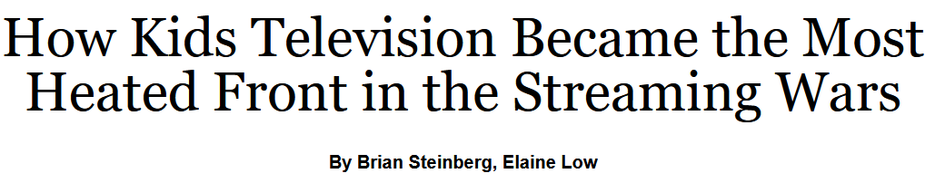

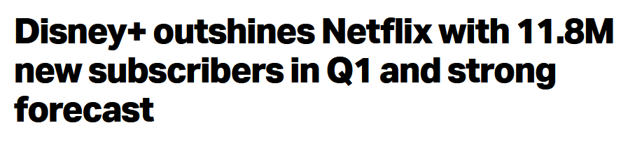

Slide 5
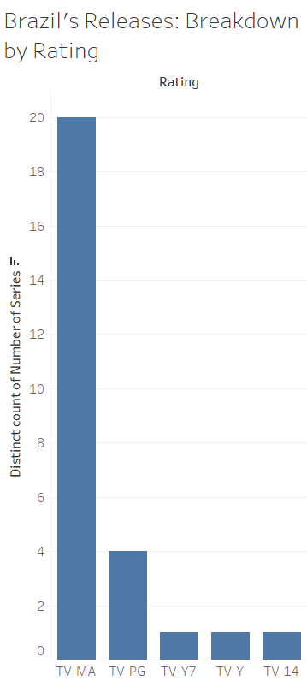
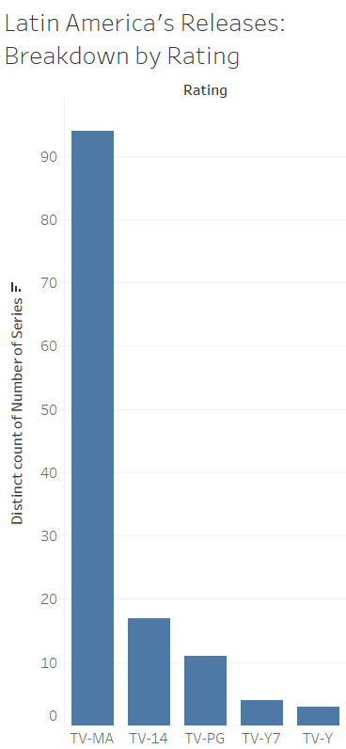
TV Ratings

Slide 6
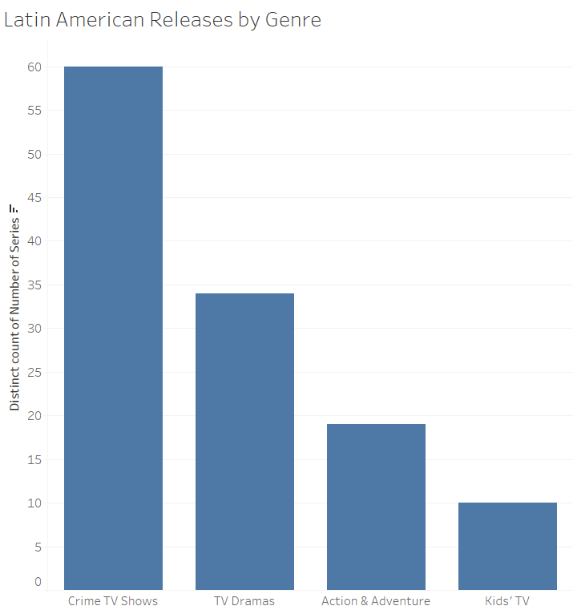

Slide 7
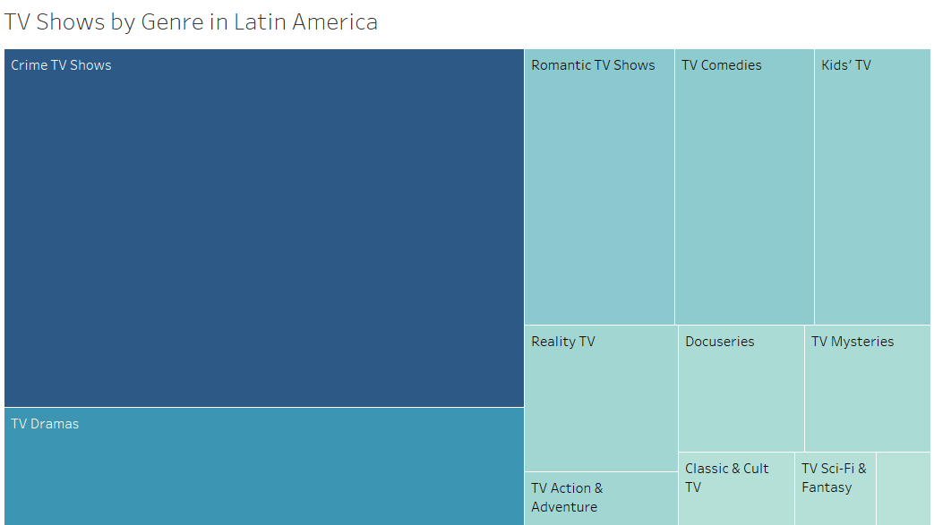

Slide 8
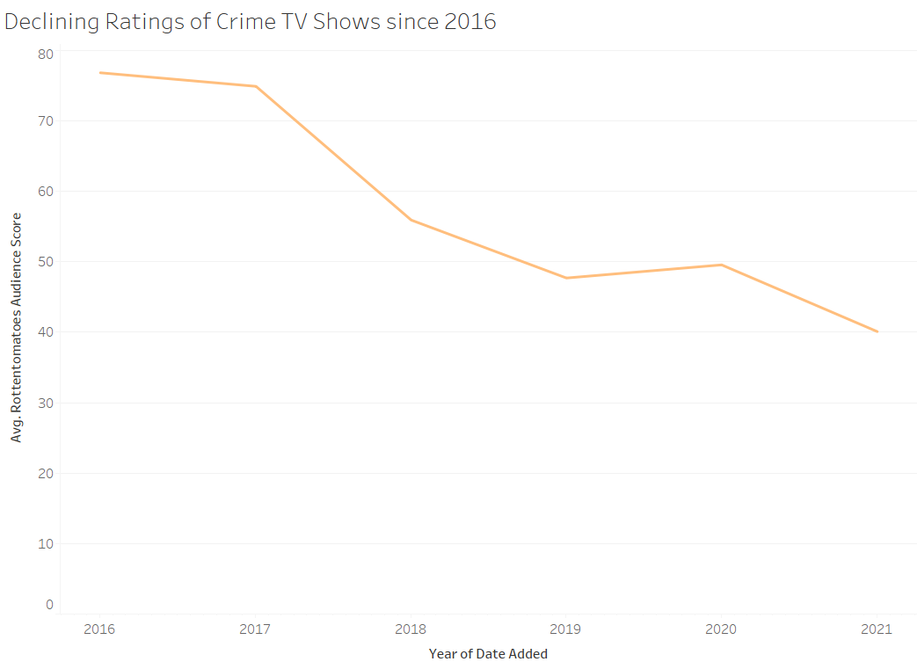
Crime TV Shows: A Declining Investment

Slide 9
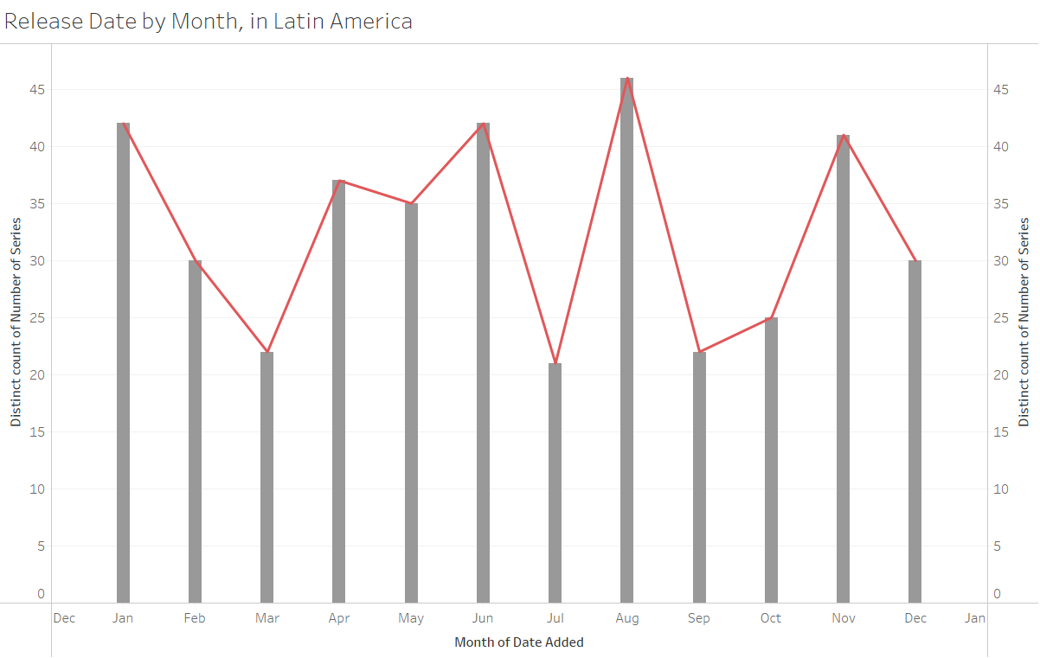
When is it a good time to launch? Consider Launch Dates

Slide 10
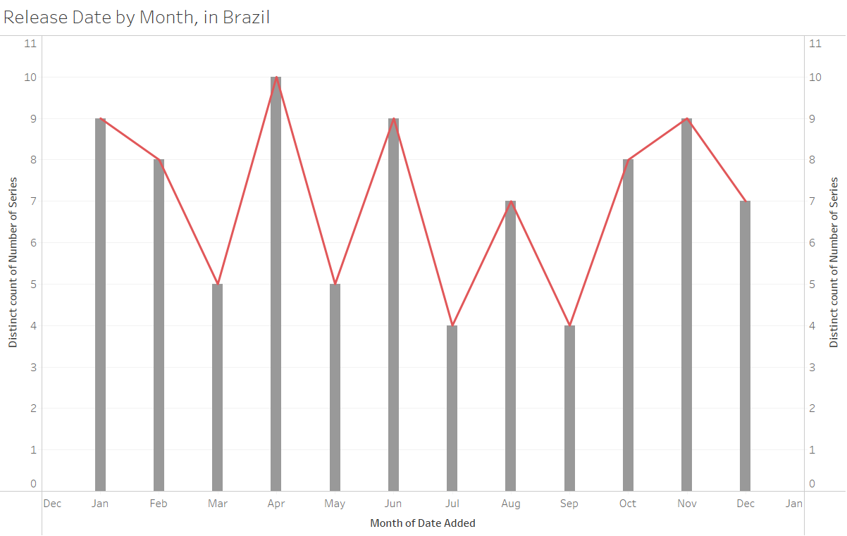

Slide 11
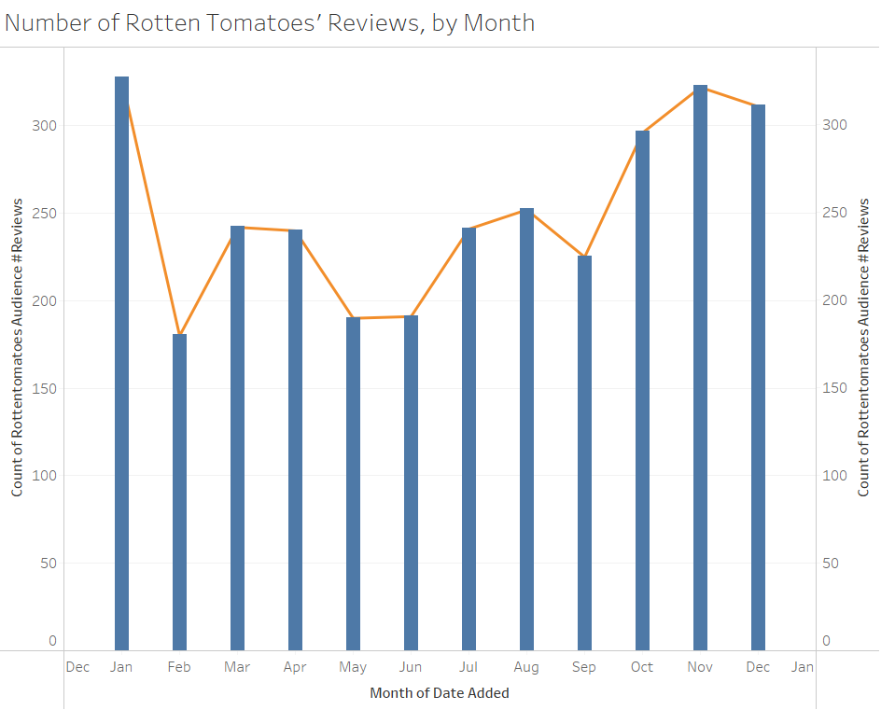
What about audience engagement?

Slide 12
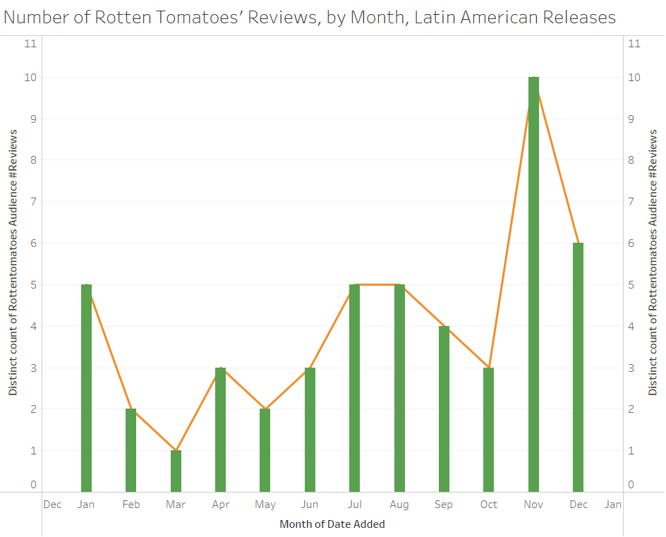

Slide 13
Recommendations
1. Investing in Kid’s TV shows will give the new streaming service an edge over Netflix
2. Don’t invest in crime TV shows: While popular, it’s a saturated market, and a declining one at that.
3. If you plan on launching in Brazil, some good dates to are late July/early August, November, or the Easter Holidays.

Slide 14


Thank You
Ruben Robles
rroblesm@itam.mx
LinkedIn: ruben-margueri
Sources
Stoll, Julia. “Leading Netflix markets worldwide 2021” Statista, 20 Sept. 2021, www.statista.com/statistics/499844/netflix-markets-penetration/. Accessed 4 May 2022.
Steinberg, Brian. “How Kids Television Became the Most Heated Front in the Streaming Wars” Variety, 27 Jan. 2021, variety.com/2021/tv/news/kids-television-streaming-netflix-apple-disney-nickelodeon-1234891622/. Accessed 4 May 2022.

